Slide 1
Weston Public Schools
Superintendent’s Proposed 2023 Budget
The mission of the Weston Public Schools, as a caring and supportive community partnership, is to empower each student to achieve success and contribute to our global society by developing and cultivating character, knowledge and creativity through a dynamic learning experience that challenges each student to continually pursue personal excellence.

Slide 2
2023 Proposed Operating Budget
Ensure the district budget fulfills the community expectations for its children
Continue Weston’s exemplary reputation as one of the highest achieving school districts in both state and nation
Maximize the funding without overburdening taxpayer
$56,976,717
An increase of 3.46%
This increase includes $434,330 or .78% for the funding of dental claims, which had been fully funded from the town’s Internal Services Fund this year.
Without dental, the budget increase would be 2.68% or $1,476,629 from 2022

Slide 3
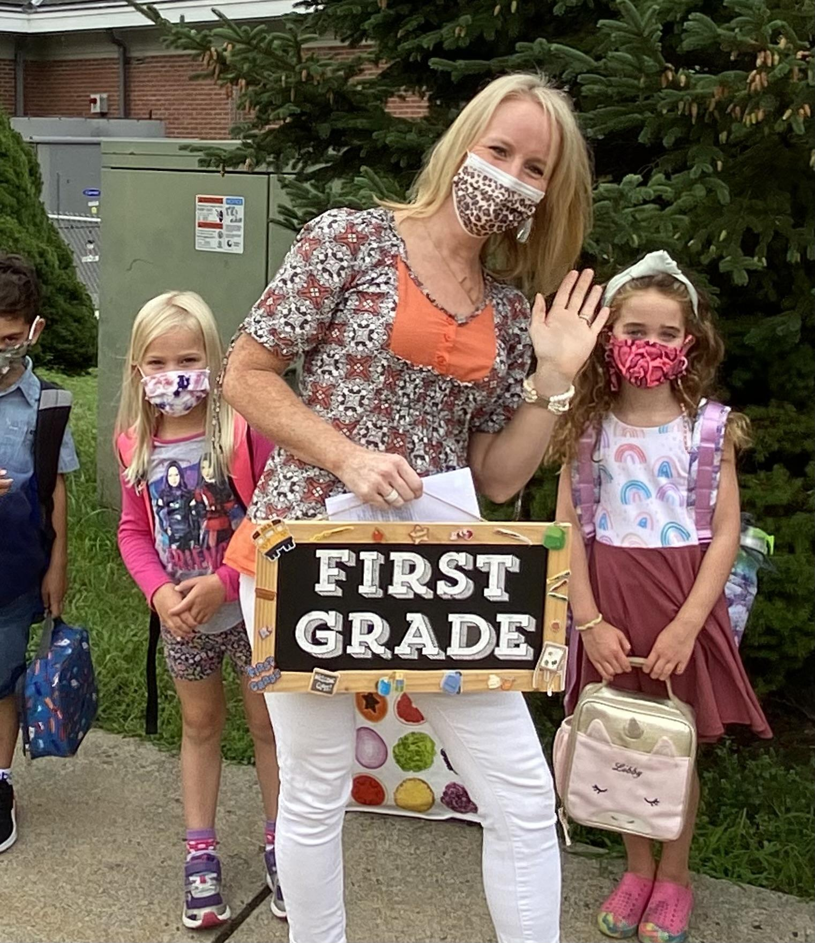
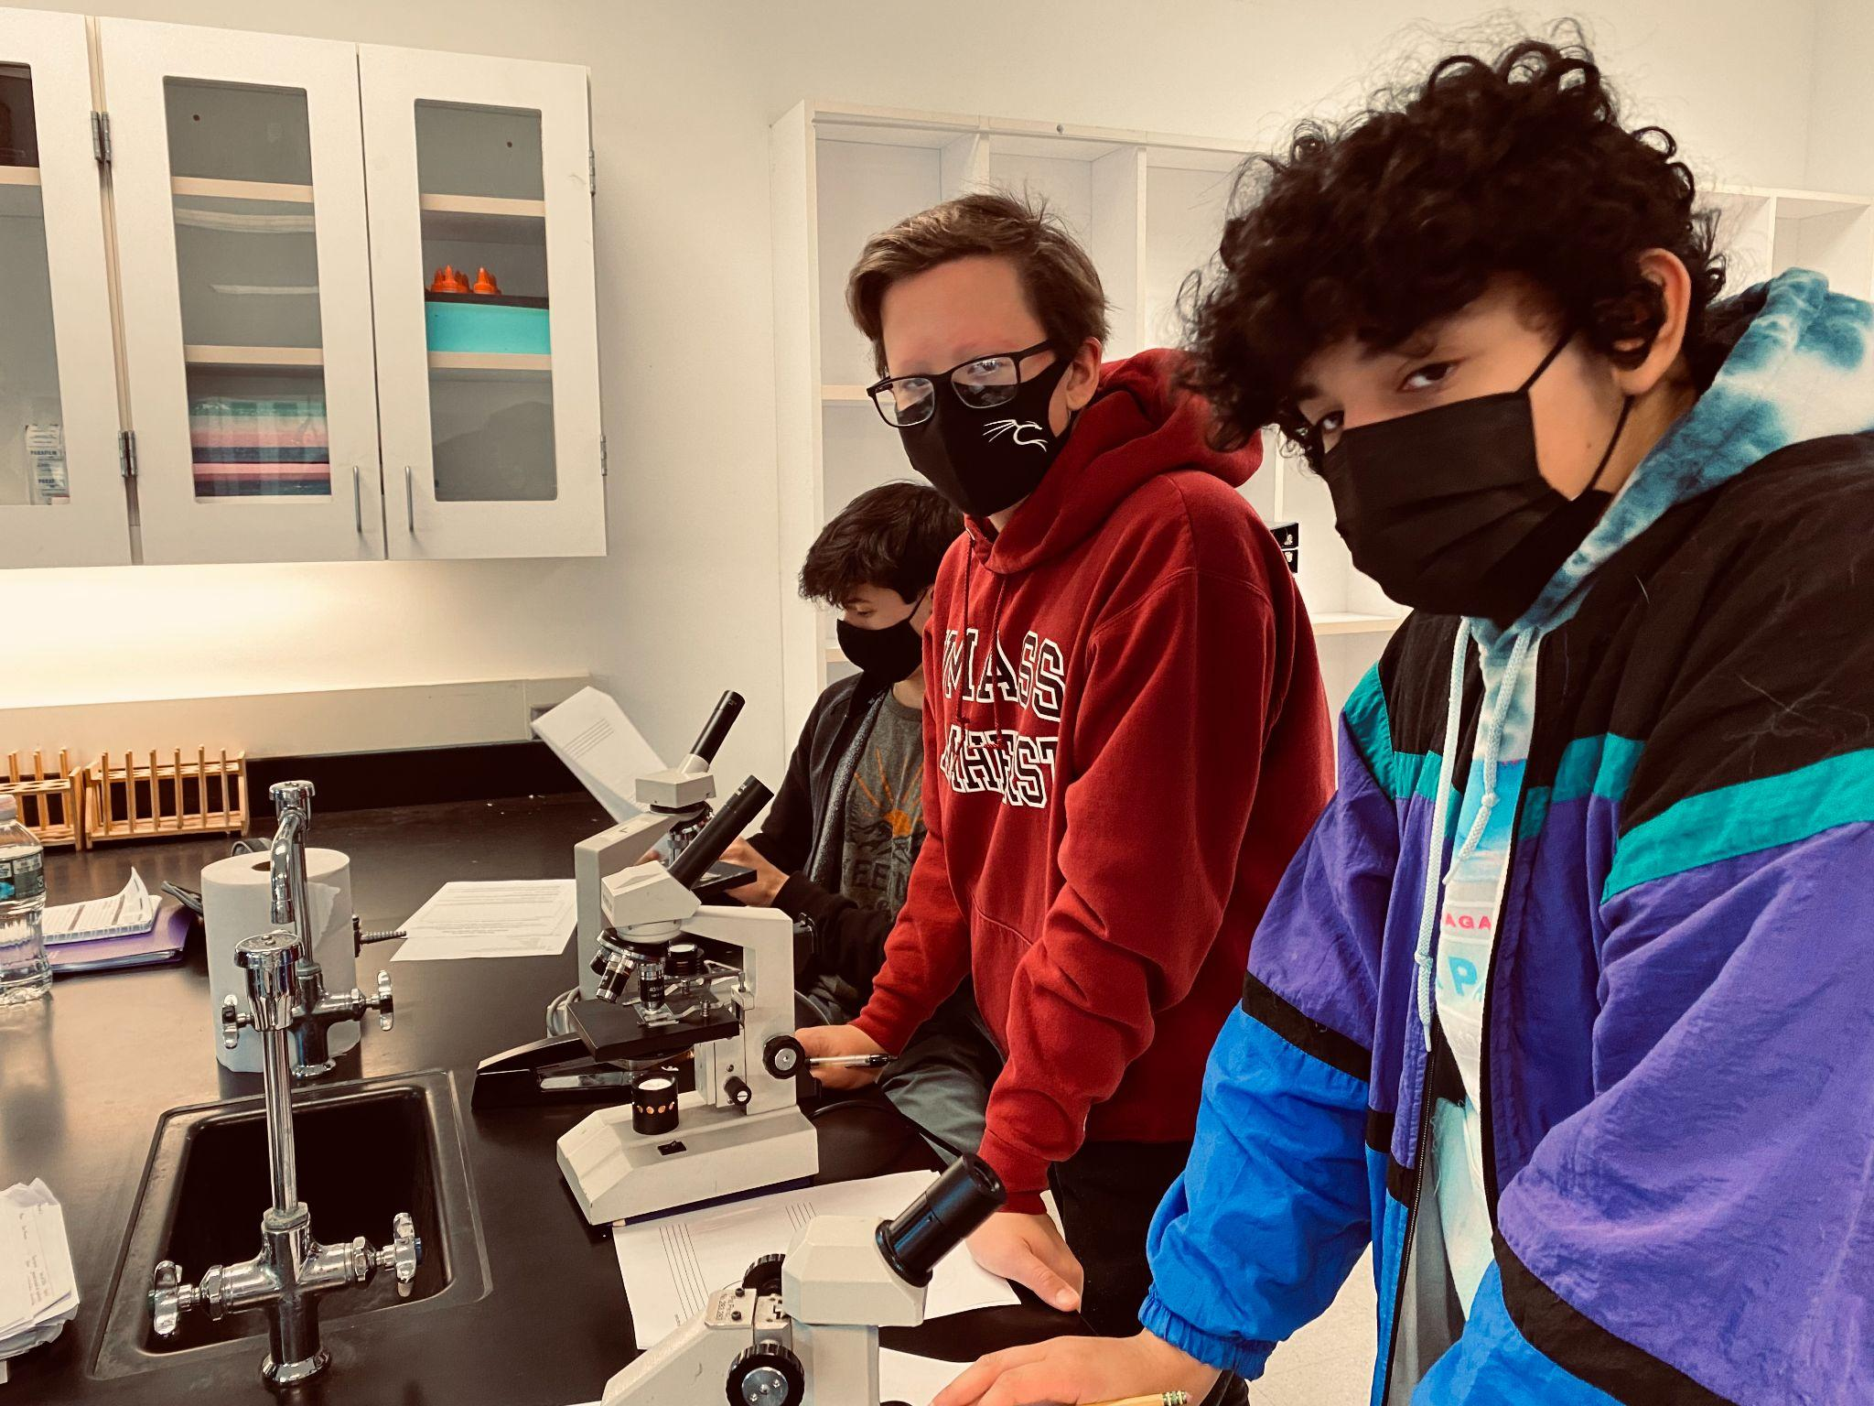
Strategic Goals
Support Weston’s Portrait of the Graduate, pre-K-12 journey
Improve student academic performance
Ensure that students demonstrate academic growth in math & reading
Promote an inclusive climate
Provide students with appropriate social emotional supports
Fulfill our responsibilities to our students with disabilities
Support the maintenance, safety and security of our campus
Maximize financial resources through lens of academic return on
investment

Slide 4
HES WIS WMS
Curriculum and Instruction
Support 22 sections of grades K-2
Support 3 sections of Pre-School (IDEA PreSchool)
Support 21 sections of Grades 3-5 (one less section grade 5)
Return to a pure teaming model for English, math, science and social studies (WMS_
Replace quiet study with Academic Workshop model (WMS)
Math & Reading
Math Curriculum Instructional Leader (CIL) at HES
Purchase new digital and consumable math resources for all kindergarteners.
Provide professional development in math & Reading (Title II/ESSER)
Maintain the staffing levels of math and reading interventionists
Digital Learning and Technology
Provide all kindergarteners with new IPADS
Purchase educational software & licenses for TABLEAU, a data analytics program

Slide 5
HES WIS WMS
Special Education
Fulfill our responsibilities to students with individualized education plans (IEP).
Support the position of a district school psychologist to assist in the increased testing demands across the schools.
Pupil Personnel Services
HES- Reallocate the cost of one of the two school psychologists to staff a school social worker
Healthy Learning Environment
Promote an inclusive climate through Positive Behavioral Interventions and Supports Program (PBIS)
Support a strong sense of community within grade level teams & schools
Support Clubs, Theater, Co-curricular programs

Slide 6
Weston High School
Curriculum and Instruction
Offer new electives: Sustainability, Digital Illustration & Animation, 12th grade English
Implement new State of Connecticut unfunded mandates for graduation
Support a NEASC Coordinator (.2 FTE)
Purchase Spanish digital textbooks levels 1-4
Supply materials for 42 sections of science courses/labs and 36 sections of visual arts courses
Fund dues & fees for participation in academic competitions
Maintain athletic program - 31 sports
Fund three new coaching positions: assistant coach for boys/girls cross country, assistant girls’ golf coach, & one esports coach
Support stipends for co-curricular programs
Math
Provide access to targeted math support for all students in the Math Lab
Provide professional development in math (Operating Budget/Title II/ESSER)
Purchase new digital textbooks for Algebra 2
Language Arts: Reading and Writing
Provide targeted writing support for all students - Writing Center
Purchase new textbooks for English
Update library learning center with new fiction and nonfiction books

Slide 7
Weston High School
Digital Learning and Technology
Replace all iMacs (62) in art/video labs
Special Education
Increase academic staffing for Alternative Pathways from a 0.8 to a 1.6 FTE teaching staff
Pupil Personnel Services
Sustain the staffing levels of one school psychologist, five school counselors, one college and career counselor, and one school social worker
Provide targeted academic support for regular education students through The Center for Academic Support & Enhancement
Healthy Learning Environment
Support a strong sense of community within the school through Advisory, PBIS coach

Slide 8
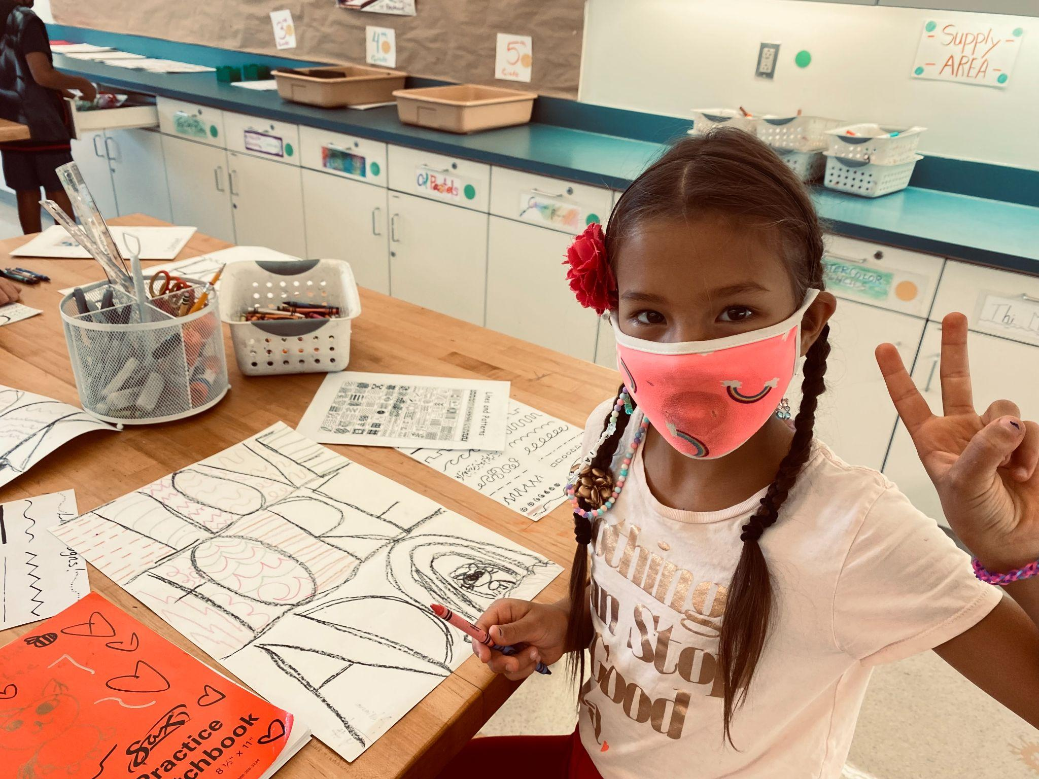
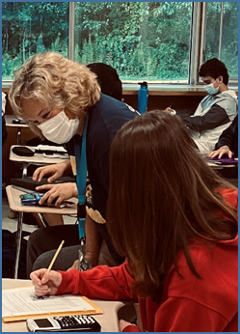
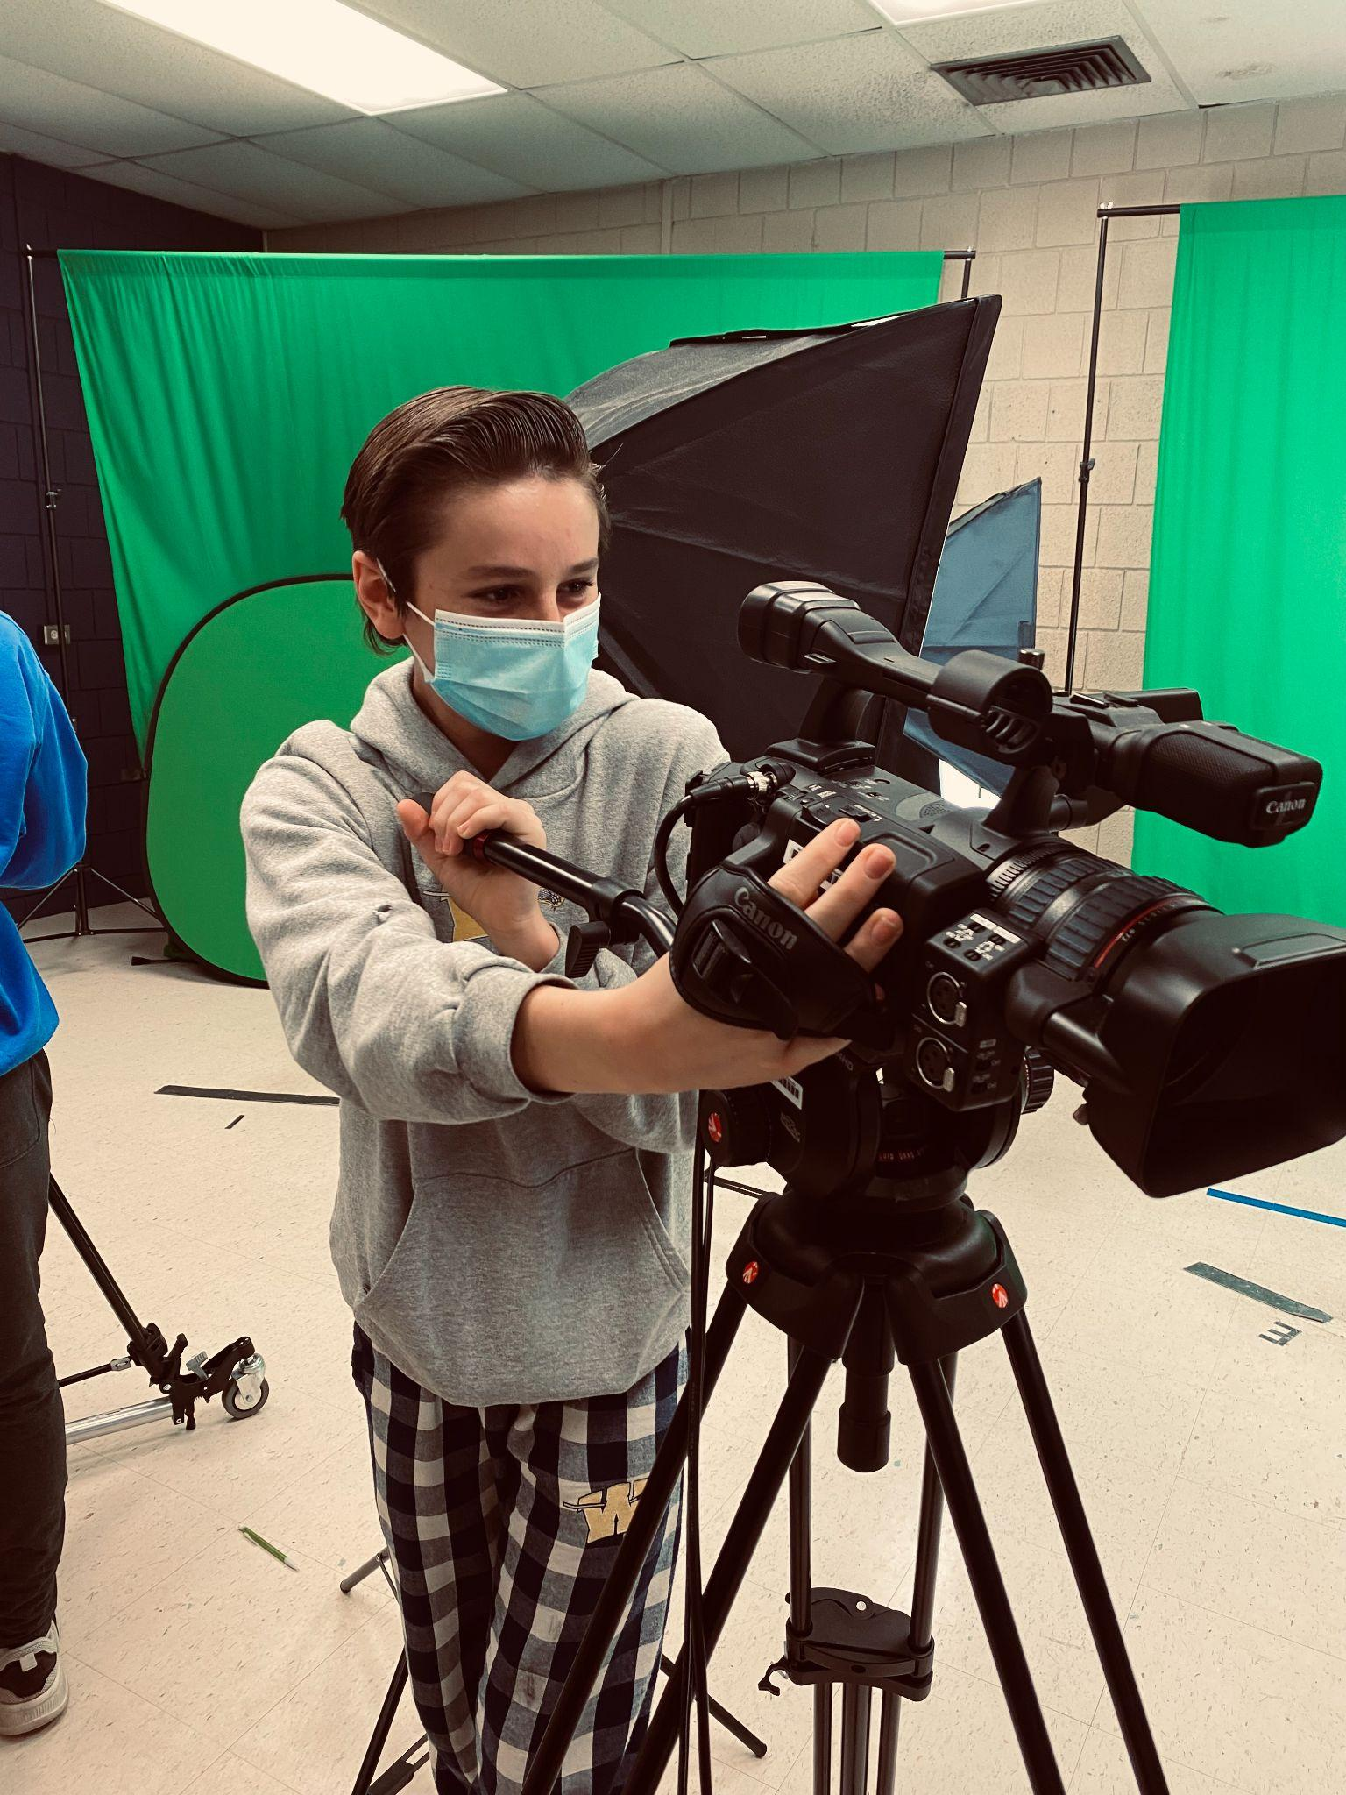
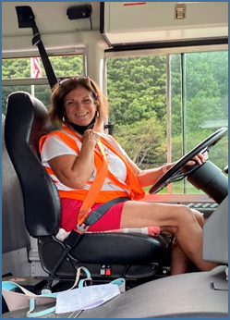
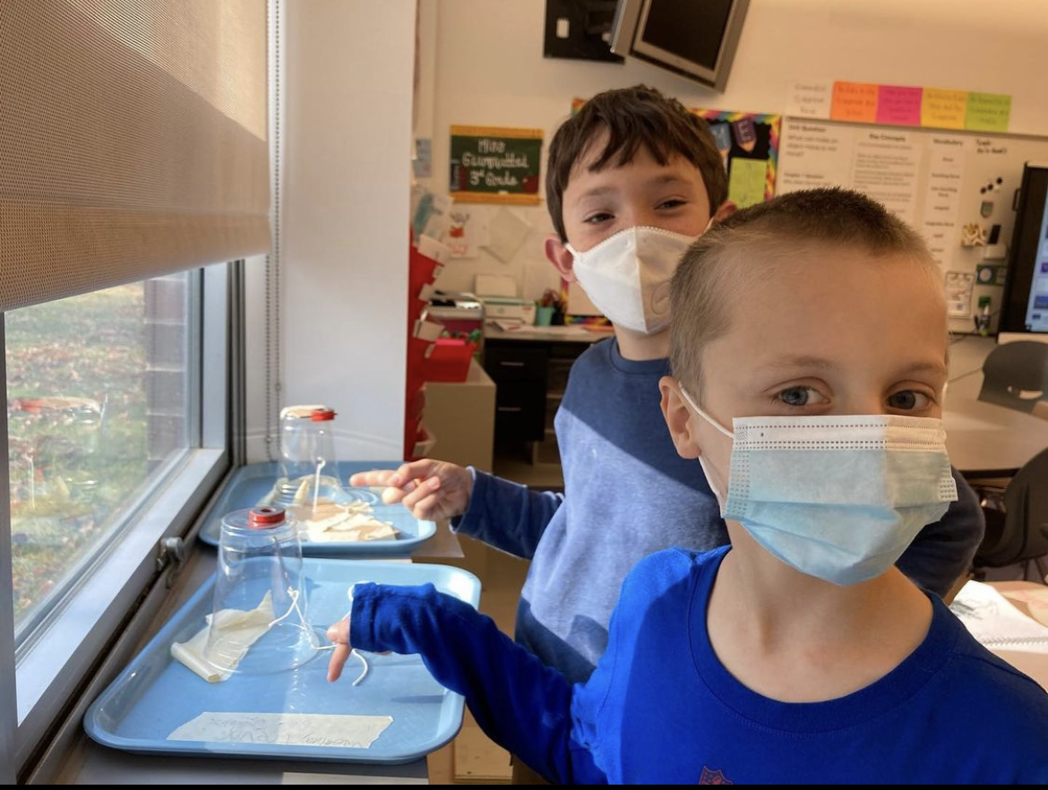
BUDGET DRIVERS
ENROLLMENT
STAFFING
SALARIES & BENEFITS
SPECIAL EDUCATION

Slide 9
Budget Driver: Enrollment

Slide 10
Staffing Reallocations & Reductions
Hurlbutt Elementary School:Increase of .4 for Lunchroom/Playground Monitors
Weston Intermediate School: Decrease of 1 Grade Five Section (enrollment)
Weston Middle School: Decrease of 1.6 FTE (reallocations and strengthening academic grade level team)
Weston High School: Decrease of 2 FTE (enrollment and reallocations)
The total increase in salary accounts is $60,911 representing .11% increase to the 2023 budget. The total cost of salaries is $33,686,260
CONTRACTUAL OBLIGATIONS - THIRD YEAR OF THREE YEAR CONTRACTS
WTA: .75 General Wage Increase (GWI) plus step, and a GWI of 1.7% at maximum step.
AFSCME: 2.0% GWI plus step.
WAA: 2.25% GWI

Slide 11
Benefits
The increase in costs for employee benefits (without including dental claims) is
$548,754 representing a 1% increase to the budget.
The cost of dental claims is $434,330 representing a .79% increase
The total cost of benefits is $10,989,015 representing a 1.79% increase to the 2023 budget
Contributing Factors:
District portion of municipal employee retirement services $1,324,006 representing a .22% increase to the budget
District Early Retirement Incentive Plan- final year- $130,080
Benefits include social security, unemployment, medicare, tuition reimbursement, life and disability insurance, WTA sick bank

Slide 12
Health Insurance
CT State Partnership Plan has increased by 6.5%
District Cost for Health Insurance (with dental)
$9,810,243
Mitigated by Employee Cost Share $1,677,851
Medical Plan Highlights
CT State Partnership Plan – Anthem Network
In Network/ Out of Network Options
3 Levels (Employee only/ Employee +1/ Family)
No deductible for In Network
$15 Co-Pay
4 Tier RX Plan
Out of Network Deductible $300/$900
OUt of Pocket Maximums
80/20 Cost Share after Deductible
BARGAINING GROUP | PREMIUM COST SHARE 2022-2023
Administrators | 20% Medical & 21% Dental
Teachers | 18.5% Medical & Dental
Support Staff AFSCME | 13.5 % Medical & Dental

Slide 13
Special Education Budget Drivers
We are still actively working through the academic and social-emotional challenges students are facing as a result of the pandemic
The proposed budget responds to the following:
Need for increased academic support at the HS level through the Alternative Pathways program
Restructuring mental health support provided to students: districtwide psychologist, social worker at HES, and continued consultation for mental health staff through the grant
Preparation for the rollout of the new IEP which will be introduced statewide on July 1, 2022 though the addition of district wide clerical support, also funded through the grant
Placement needs of students who require more intensive supports and services than can be provided within the district

Slide 14
Grant Highlights
Title One $61,192 Academic success
Title Two $30,220 Professional development
Title Four $10,000 District & school improvement
IDEA & $498,861 Certified staff & paras
IDEA PreSchool
ESSER $345,434 Academic/ social emotional
Support
SPED ESSER $175,248 Special education services
TOTAL $1,120,955

Slide 16
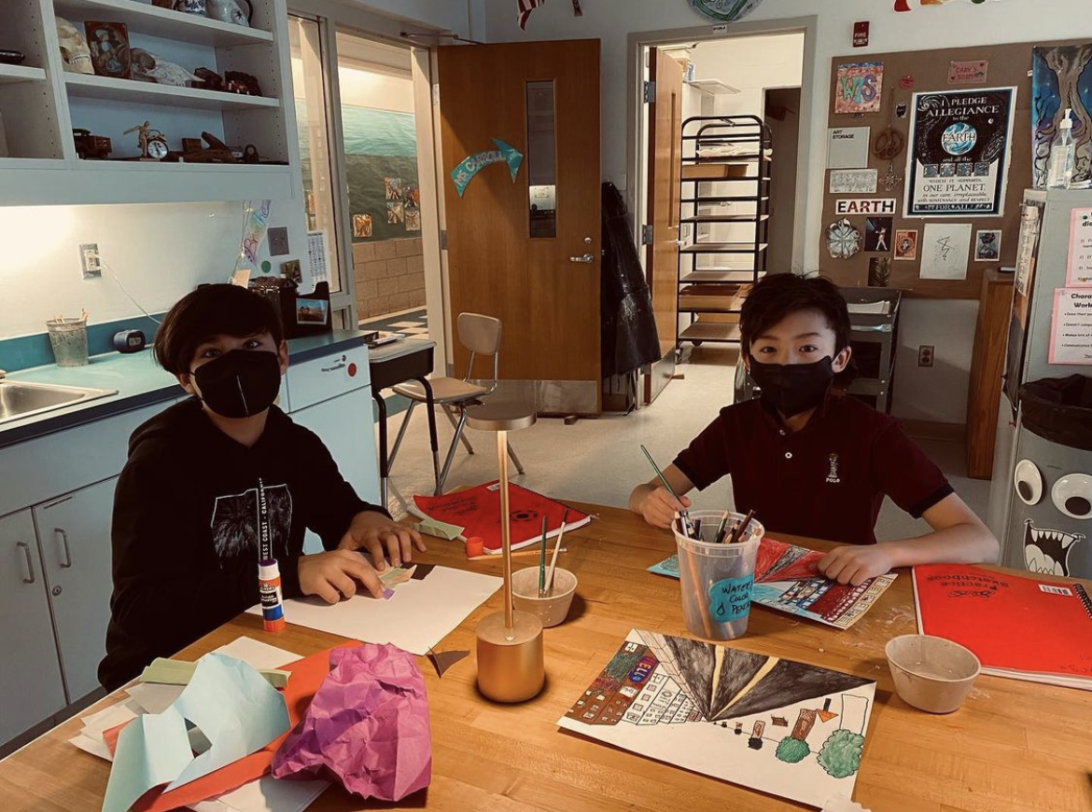
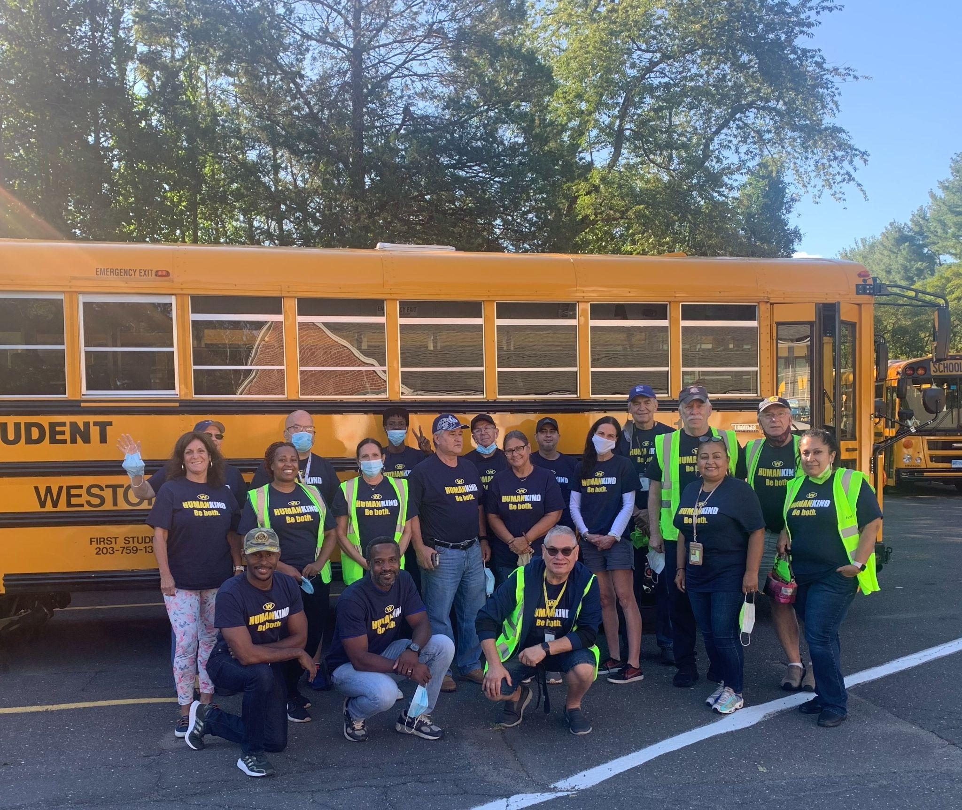
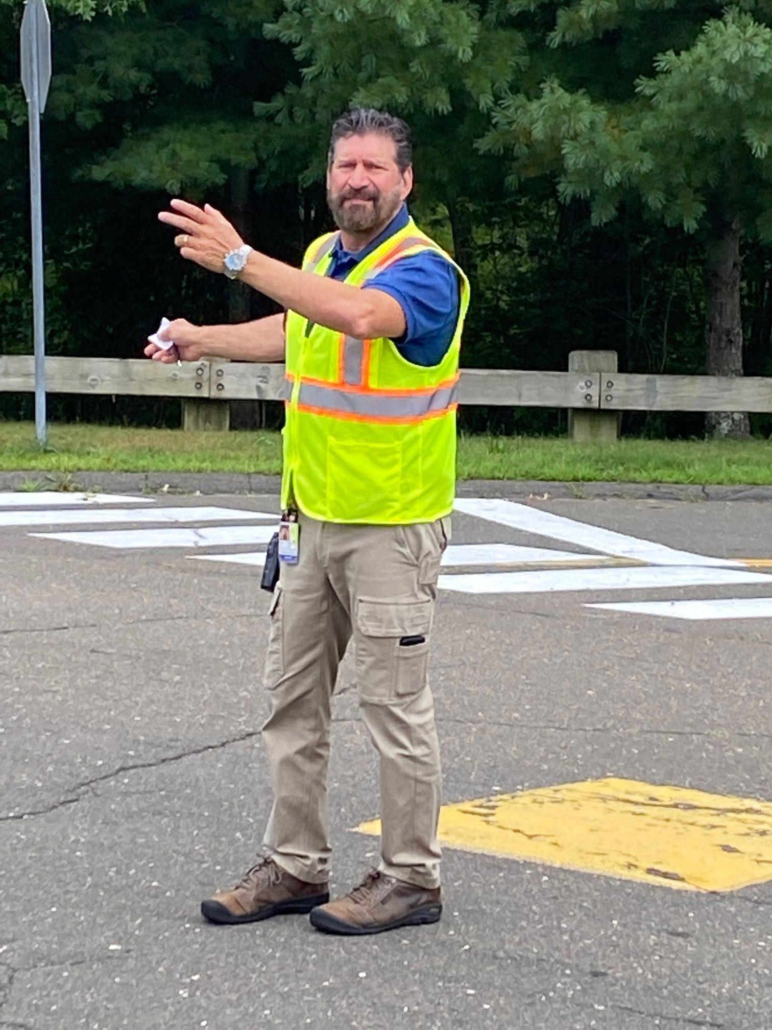
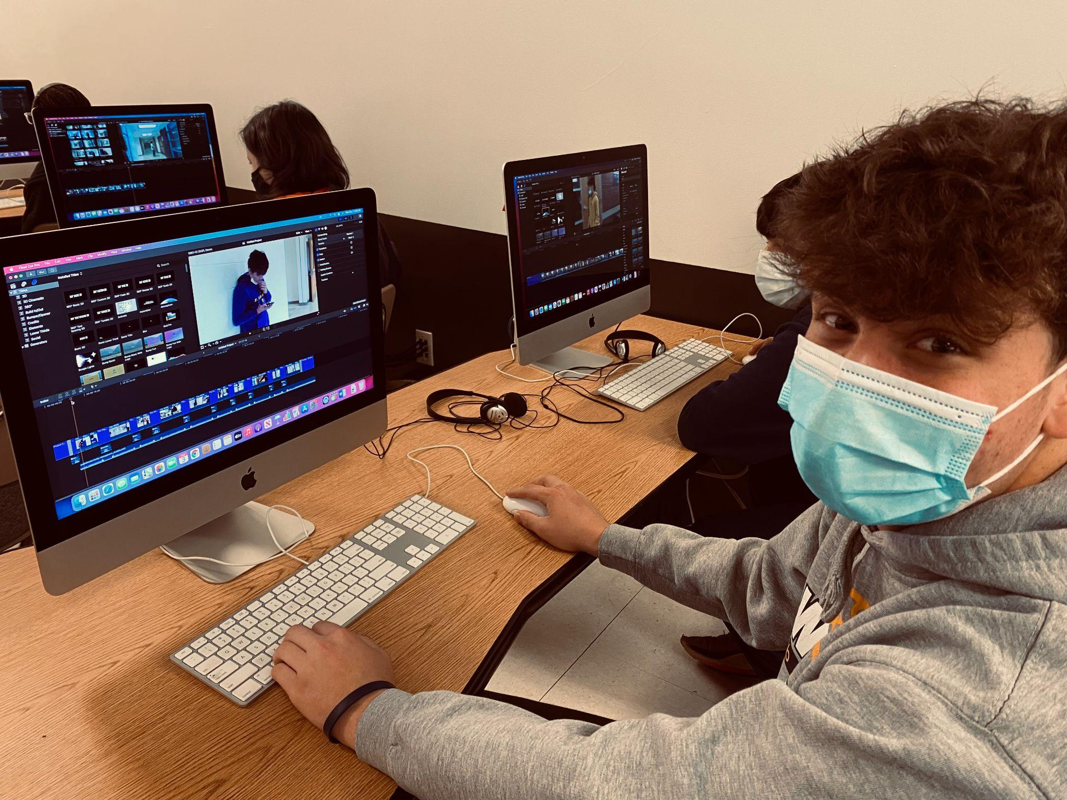
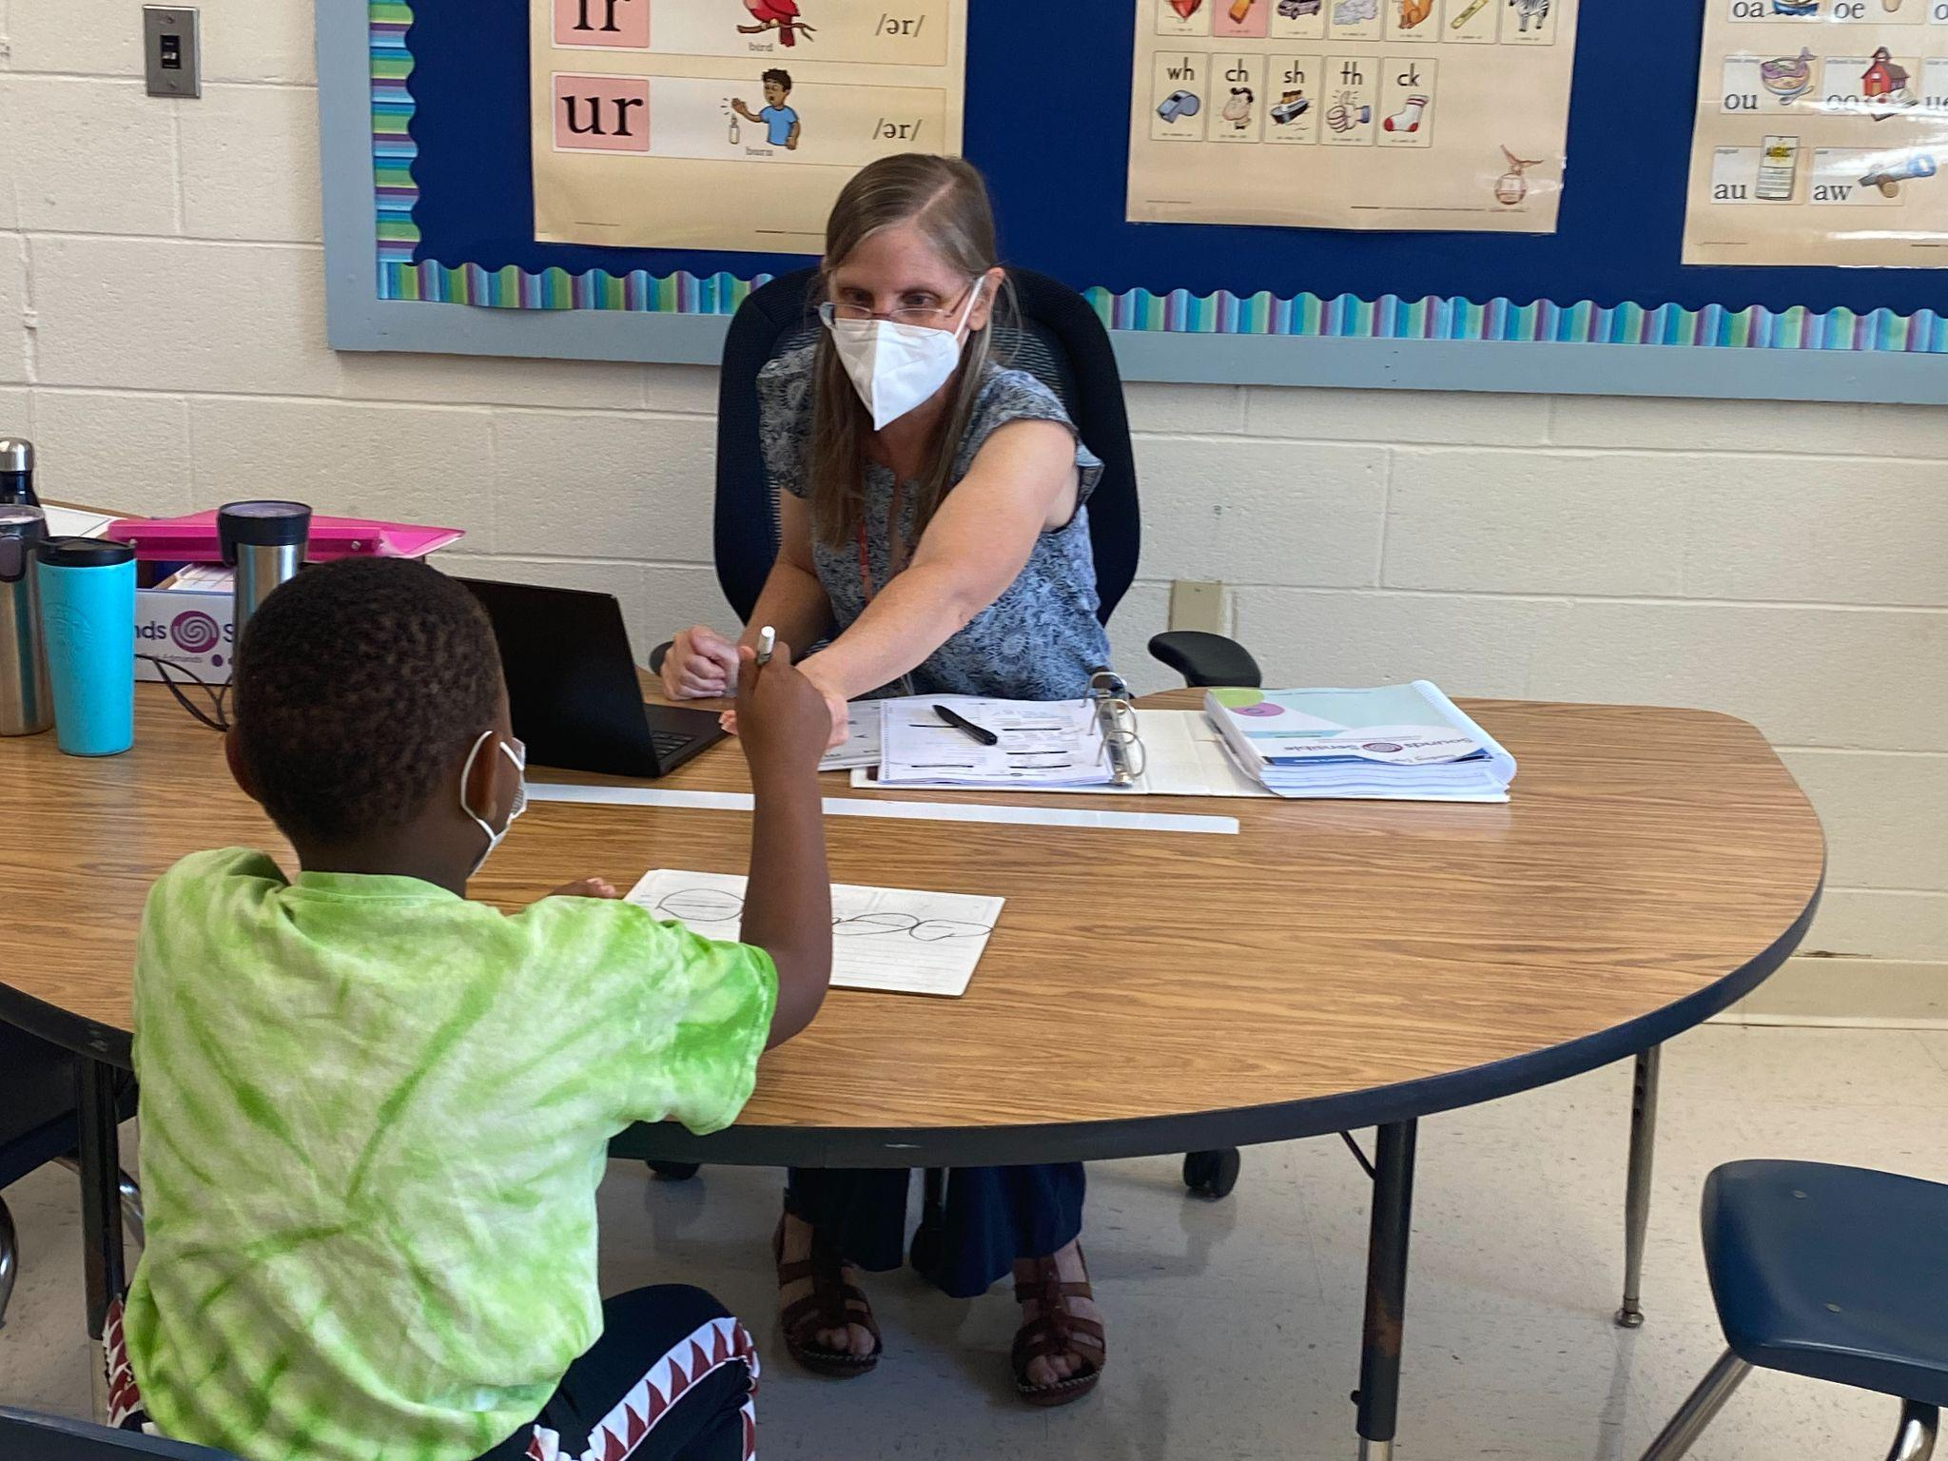
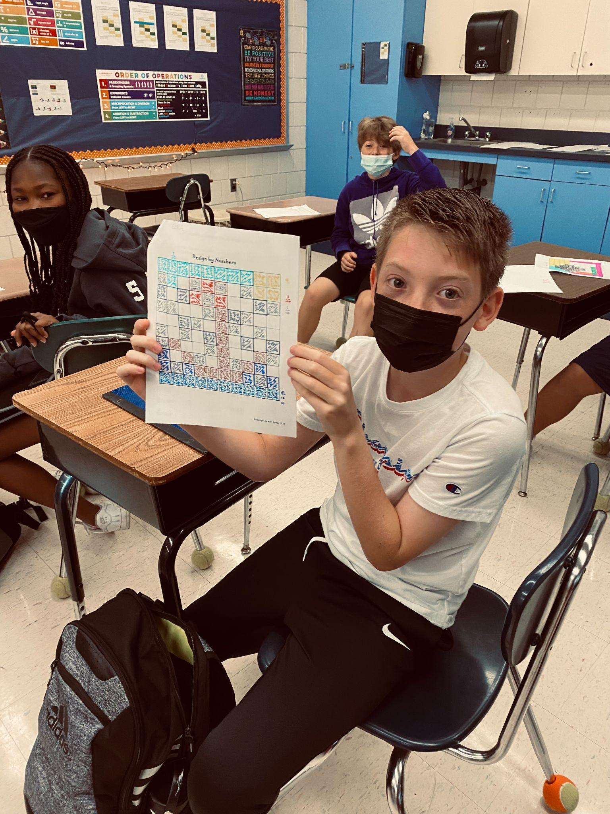
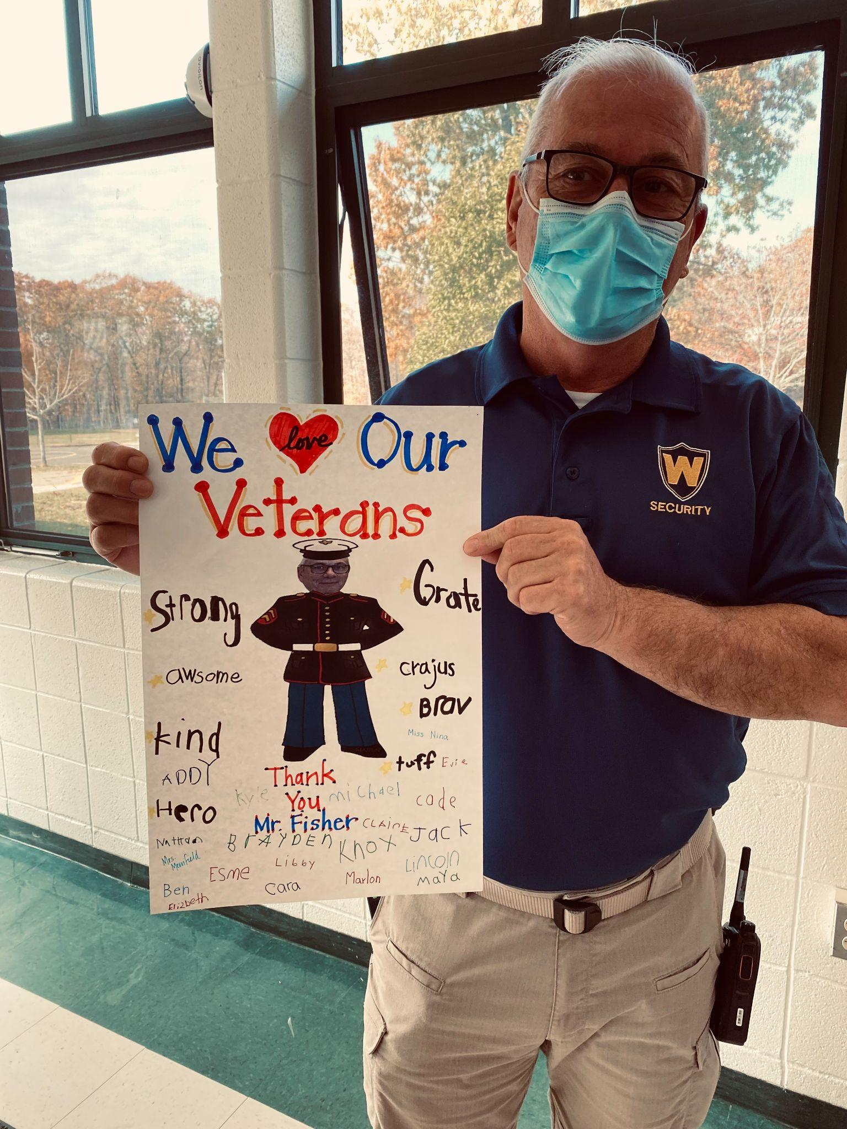
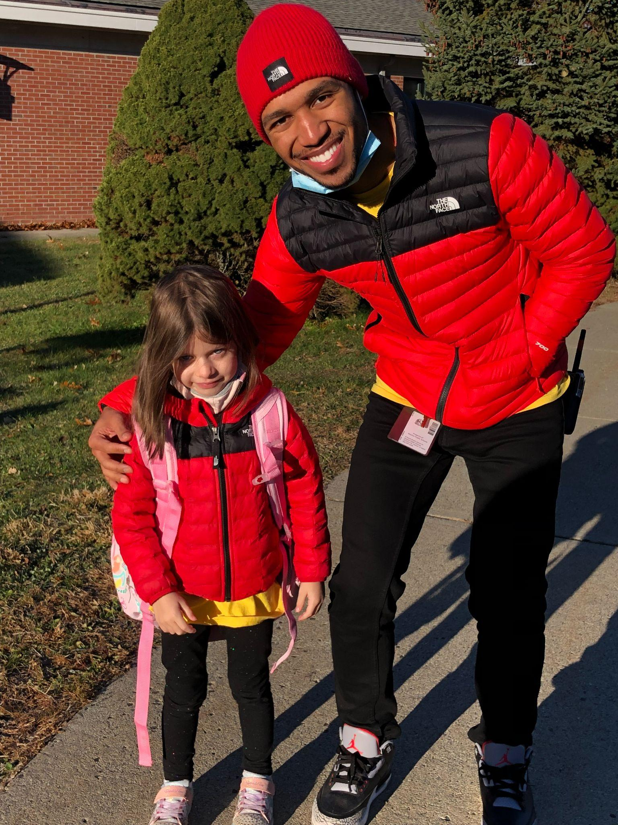
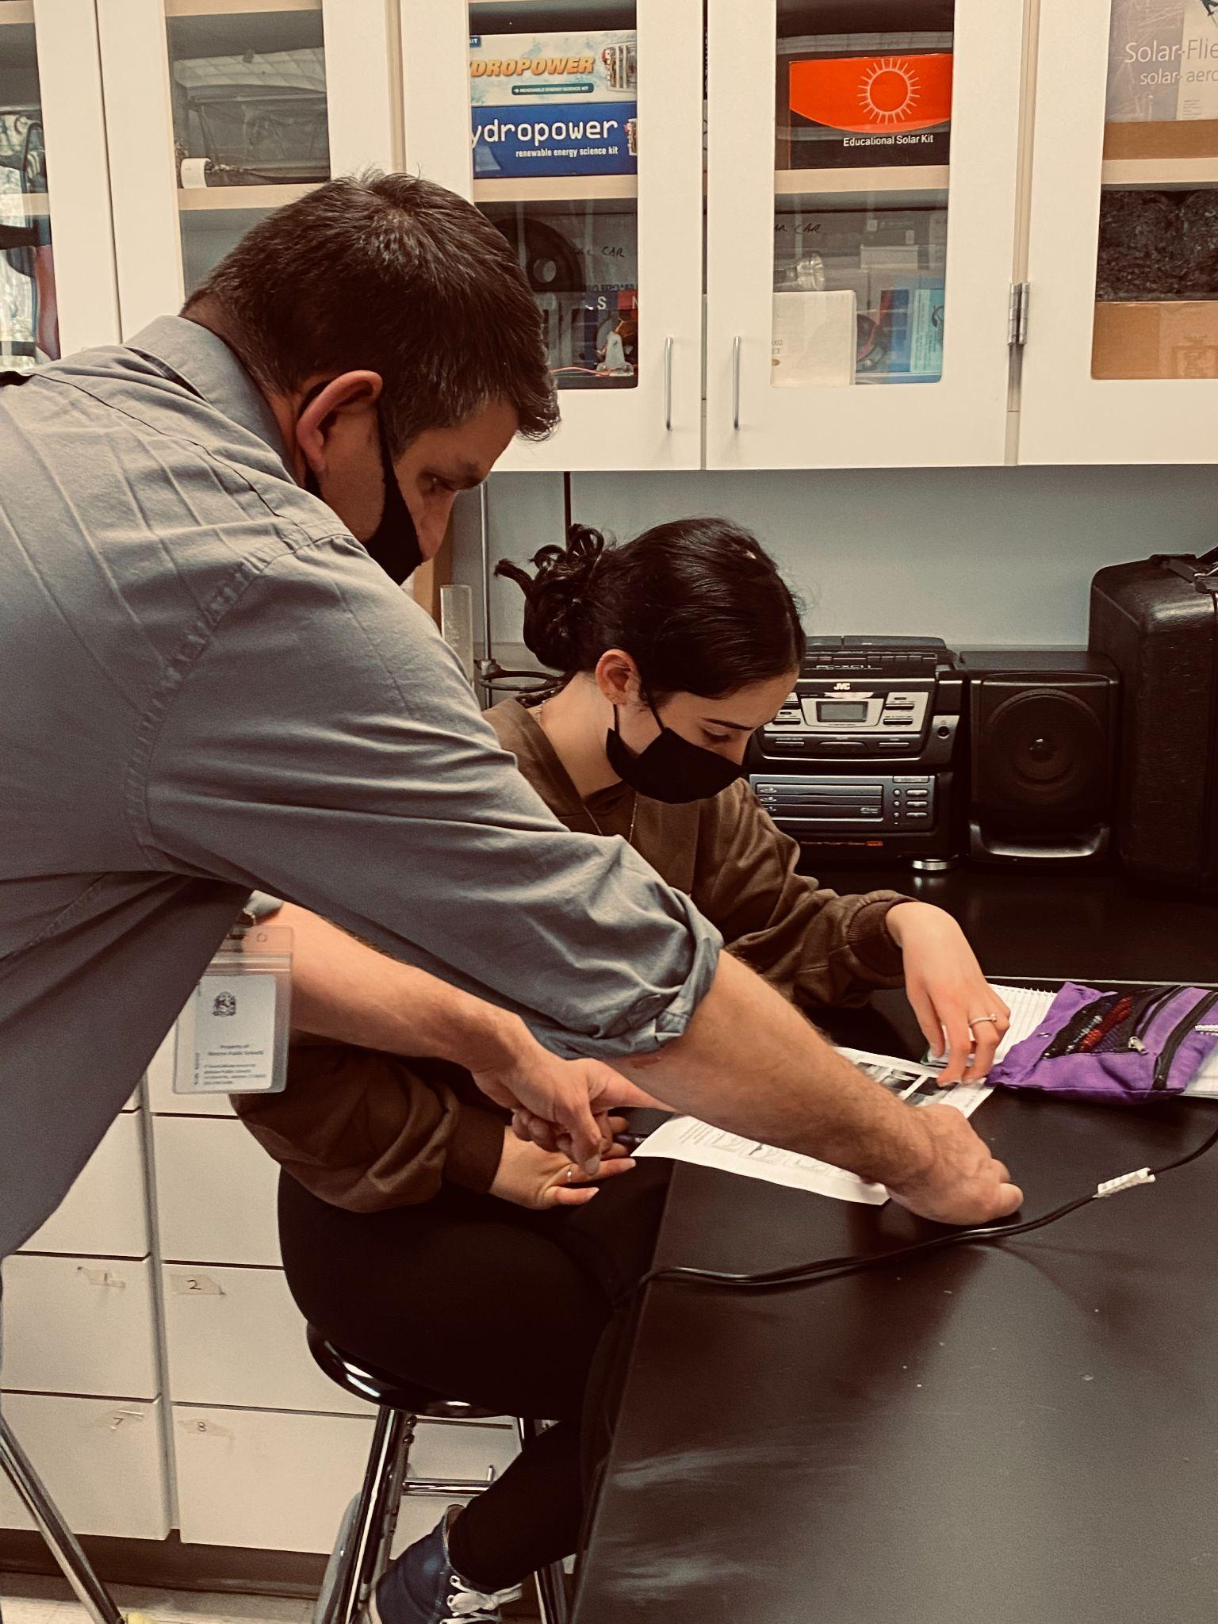
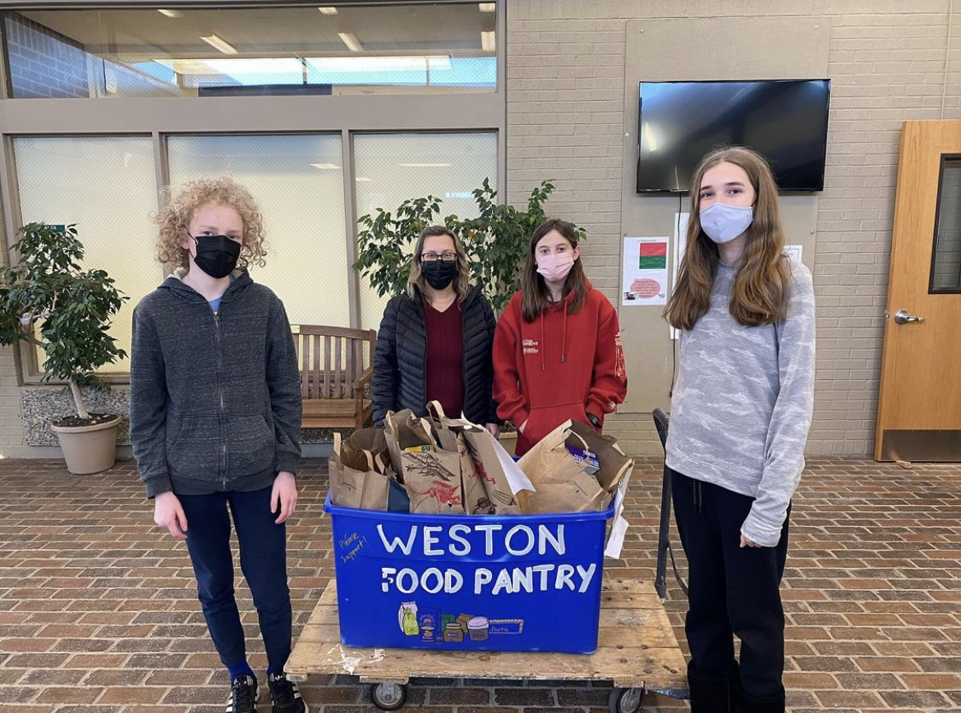
Our Schools

Slide 17
WESTON PUBLIC SCHOOLS
Our commitment to excellence and continued, purposeful innovation will make Weston Public Schools the standard in designing educational pathways and environments that cultivate empowered citizens of the global community.

Slide 18
Our commitment to excellence and continued, purposeful innovation will make Weston Public Schools the standard in designing educational pathways and environments that cultivate empowered citizens of the global community.

Slide 19
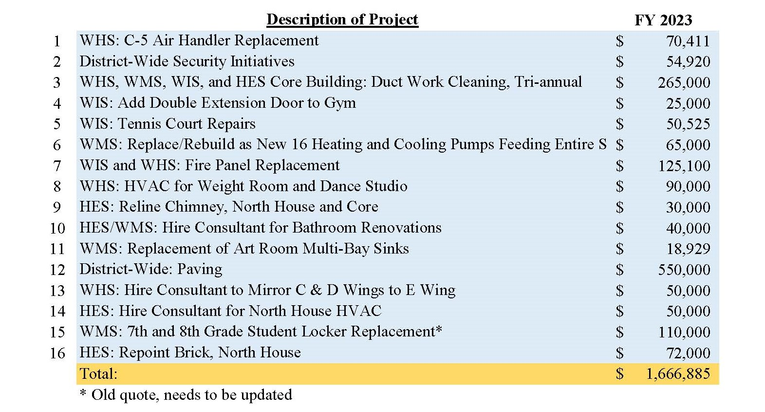
Capital Budget Proposal 2022-2023 - Facilities

