Slide 1
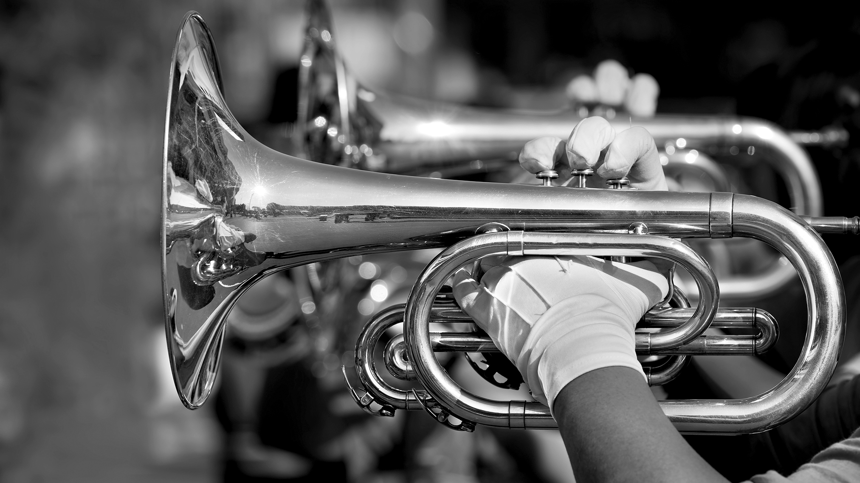
M.A.R.C.H.
Musicians Acting with Responsibility, Compassion, and Hard Work

Slide 2
What is M.A.R.C.H?
MARCH stands for Musicians Acting
with Responsibility, Compassion, and Hard work
It’s an all band fundraiser.
Our goal is to raise a significant amount of the operational funds for RHS band in a single work day.
We are also striving to create ownership within the band student body while making a substantial impact in our community.
100% of the funds raised will go directly to our band program!

Slide 3
What are the funds use towards?
Our goal is to raise as much funding as we can to offset all the band programs; classroom, marching band, guard and indoor drumline
Fundraising supports additional specialist staff, competition fees, transportation, driver for equipment trailer, classroom fees, repair and replacement of equipment, props for shows and more

Slide 4
For this event to be significantly effective, it is required for ALL of our musicians and color guard members to participate.

Slide 5
There are TWO PARTS to this fundraiser: raising funds, and a service work day.

Slide 6
Part 1: Raising Funds
Sunday, March 26th The MARCH online Campaign is live.
We will accept cash, check, credit card or PayPal payments on Your MARCH campaign page. All donations are tax deductible. Read the front of your packet for details.
The goal for each of you is to raise at least $300.
Our goal this year is $25,000!

Slide 7
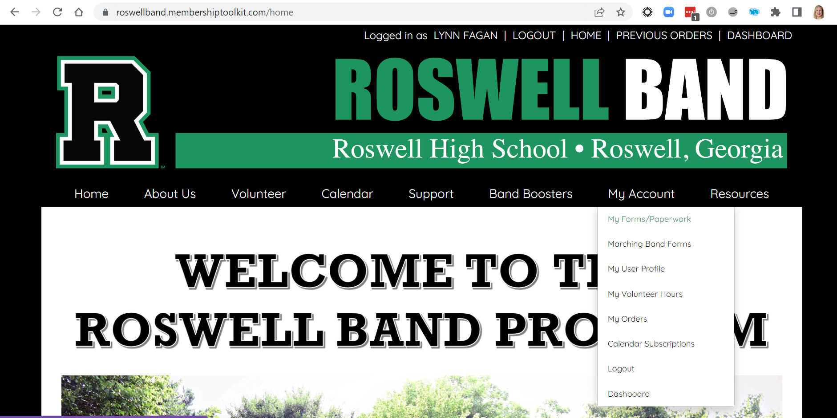
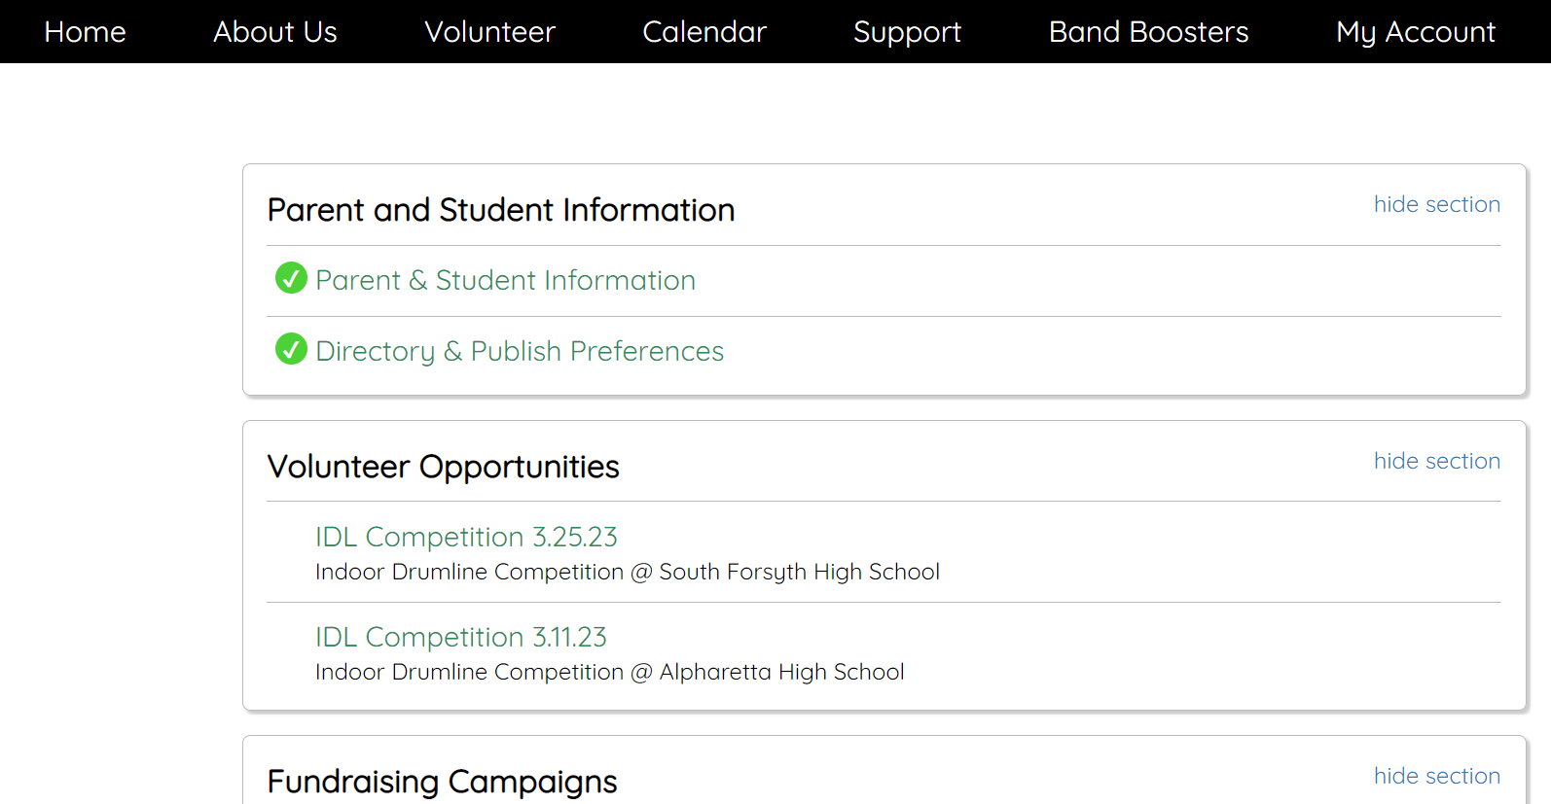
Part 1: Setup Your Personal Fundraising Page
Login to the Roswell Band Membership Toolkit Site
From the Homepage, you will find your student campaign page by navigating to My Account>My Forms/Paperwork>Fundraising Campaigns

Slide 8
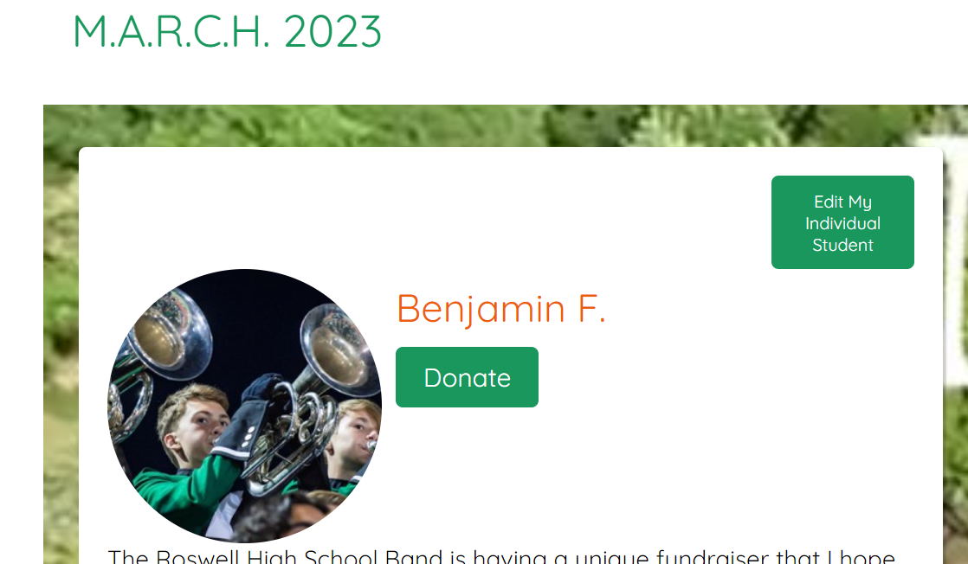
Part 1: Edit Your Personal Page
You can edit your student’s page to include a picture, modify the goal and add a preferred email for notifications.

Slide 9
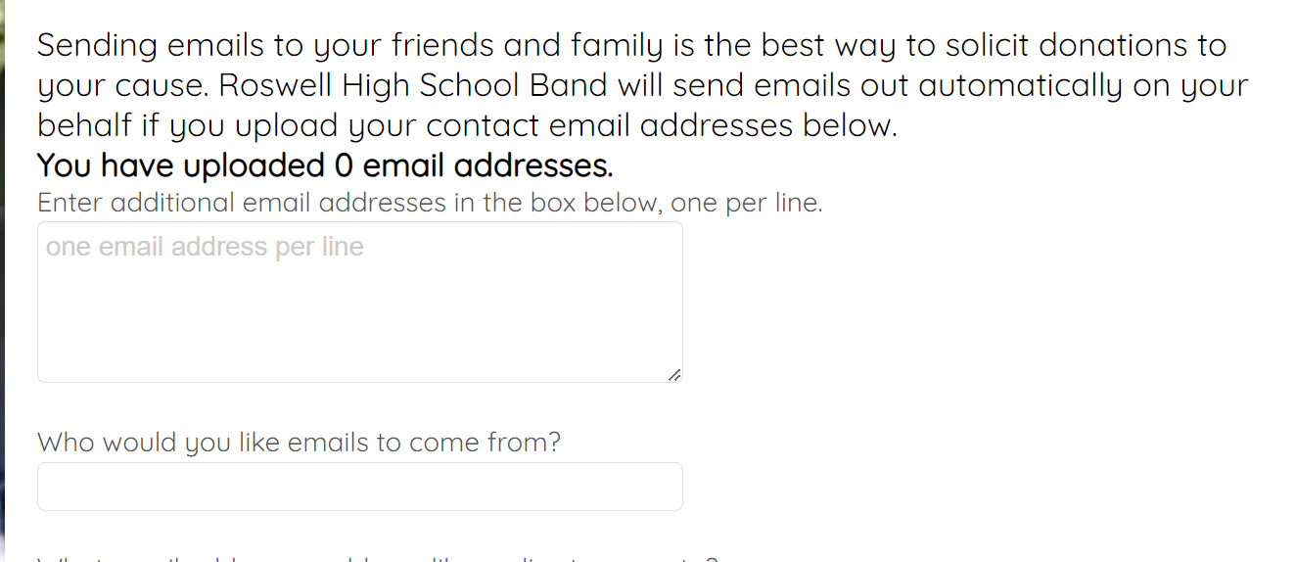
Part 1: Let Us Do the Work for You!
From the Edit My Individual Student Page; load the email addresses of your contacts by Friday, March 3rd and an automated email will be sent from Membership Toolkit with your student page to receive donations.

Slide 10
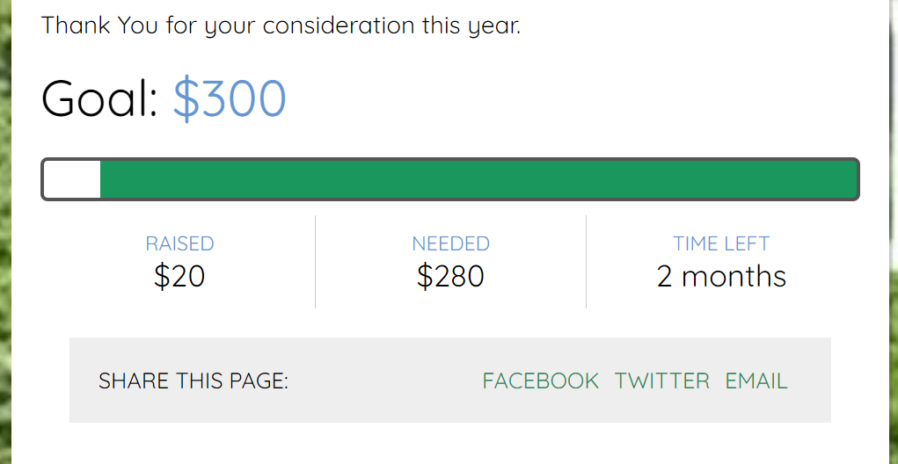
Part 1: Use Quick links to Share Your Page
From your student’s page, use the quick links to share their page via facebook, twitter and email.

Slide 11
Part 2: Service Work Day
On Saturday, March 18th ALL students commit to a 4-hour workday to give back and beautify Roswell. It’s a really fun day!
We will post sign-up sheets next week so you can pick the spot where you want to help!
Parents- we will need help with chaperoning at the sites too.

Slide 12
Part 2: Service Work Day
We'll divide among three work sites:
Don White Park
Dotsie Garner Mills Park
Waller Park
Our volunteer hours will contribute to the City of Roswell's participation in the Great America Clean-up, part of Keep America Beautiful.

Slide 13
Incentives: Individual
Every student who participates by working the event on the 18th and/or* soliciting donations will receive a t-shirt.
Students who raise at least $50.00 in donations will receive a M.A.R.C.H bracelet
Students who raise at least $300.00 will receive a $5 Starbucks gift card
In Class celebration when we reach $20,000

Slide 14
Here how you do it:
Request one $40 donation at a time. That’s basically
$10.00/per hour for
your 4-hour work day.
Set your goal to raise $100 by each Friday in
March.

Slide 15
Tips and Tricks: Asking for Donations
Use the templates in Membership Toolkit to create your personal donation page
Send emails to your family and friends -- add a personal note or even a fun band picture from our SmugMug archives.
Create a short video and share on social media; parents and students
Ask the neighbors you know -- encourage them to come to a concert or enjoy the half-time show in the Fall
$35 from 10 donors and you have hit your goal!!!

Slide 16
MUSIC IS A UNIVERSAL LANGUAGE.
What is also universal is our love of Roswell.
With M.A.R.C.H, we can’t think of a better way for our band students to give back to our community.

Slide 17
Questions?
If you have any questions, please reach out to us!
fundraising@roswellband.com
Or
President@roswellband.com

